Slide 1
Scene Creation and Management

Slide 2
Learning Objectives
Understand the concept of scenes in Unity.
Learn how to create and organize scenes effectively.
Grasp scene management techniques for complex projects.

Slide 3

What are Scenes in Unity?
Scenes are where you work with content in Unity.
They are assets that contain all or part of a game or application. ^{[8]}
A scene is the term Unity uses to describe what you might already know as a level. As you develop a Unity project, each collection of objects and behaviors should be its own scene. Therefore, if you were building a game with a snow level and a jungle level, those would be separate scenes.^{[3]}
Although it is certainly possible to build large and complex games in this way, it is generally much easier to use multiple scenes. The idea behind a scene is that it is a self-contained collection of game objects.^{[3]}
5: Thorn, Alan, Pro Unity game development with C#, 2014
8: Unity Technologies, Unity Manual, 2023
Notes:
• Definition of scenes as individual levels, environments, or segments of a game.
• Explanation of how scenes contribute to the overall structure and flow of a game project.

Slide 4
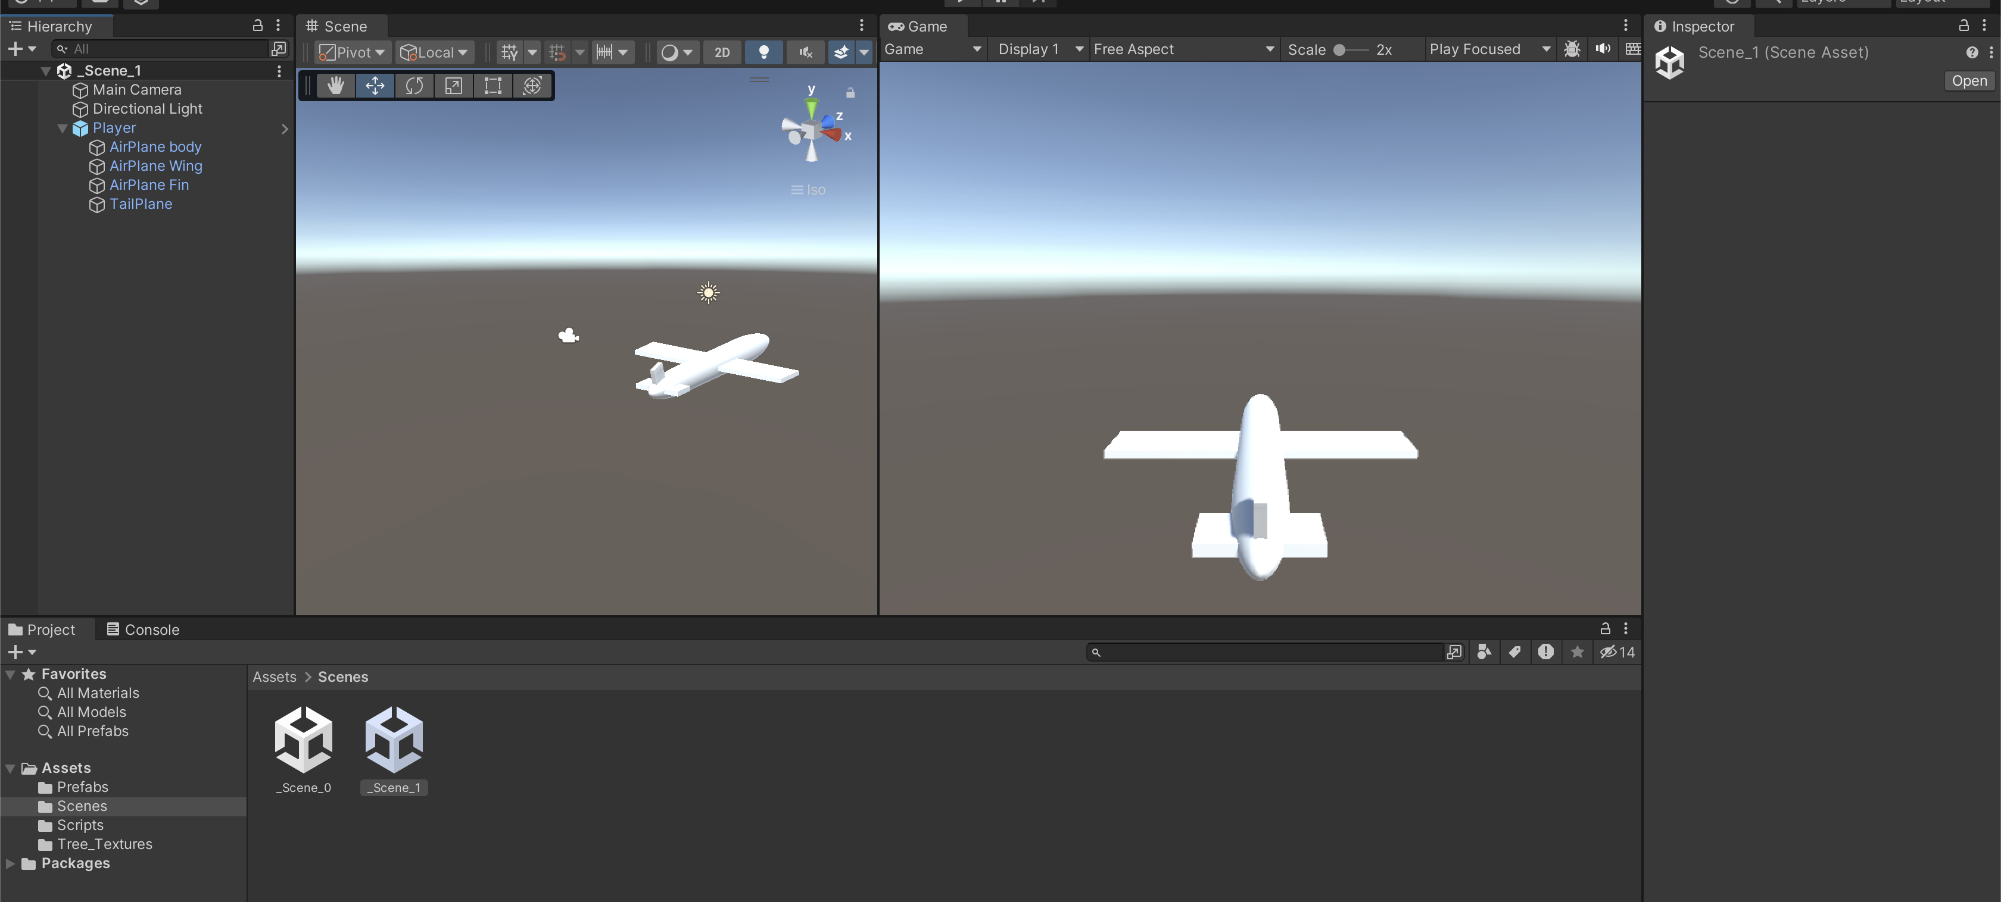
Scene Creation Basics
1. Choose File > New Scene from the menu bar
2. Choose File > Save Scene from the menu bar and name this _Scene_1
Double click on scene icon on project window to open a scene
Notes:
Tip: rename scene “You can rename the scenes inside the Project/Assets/Scenes folder, on project tab”

Slide 5
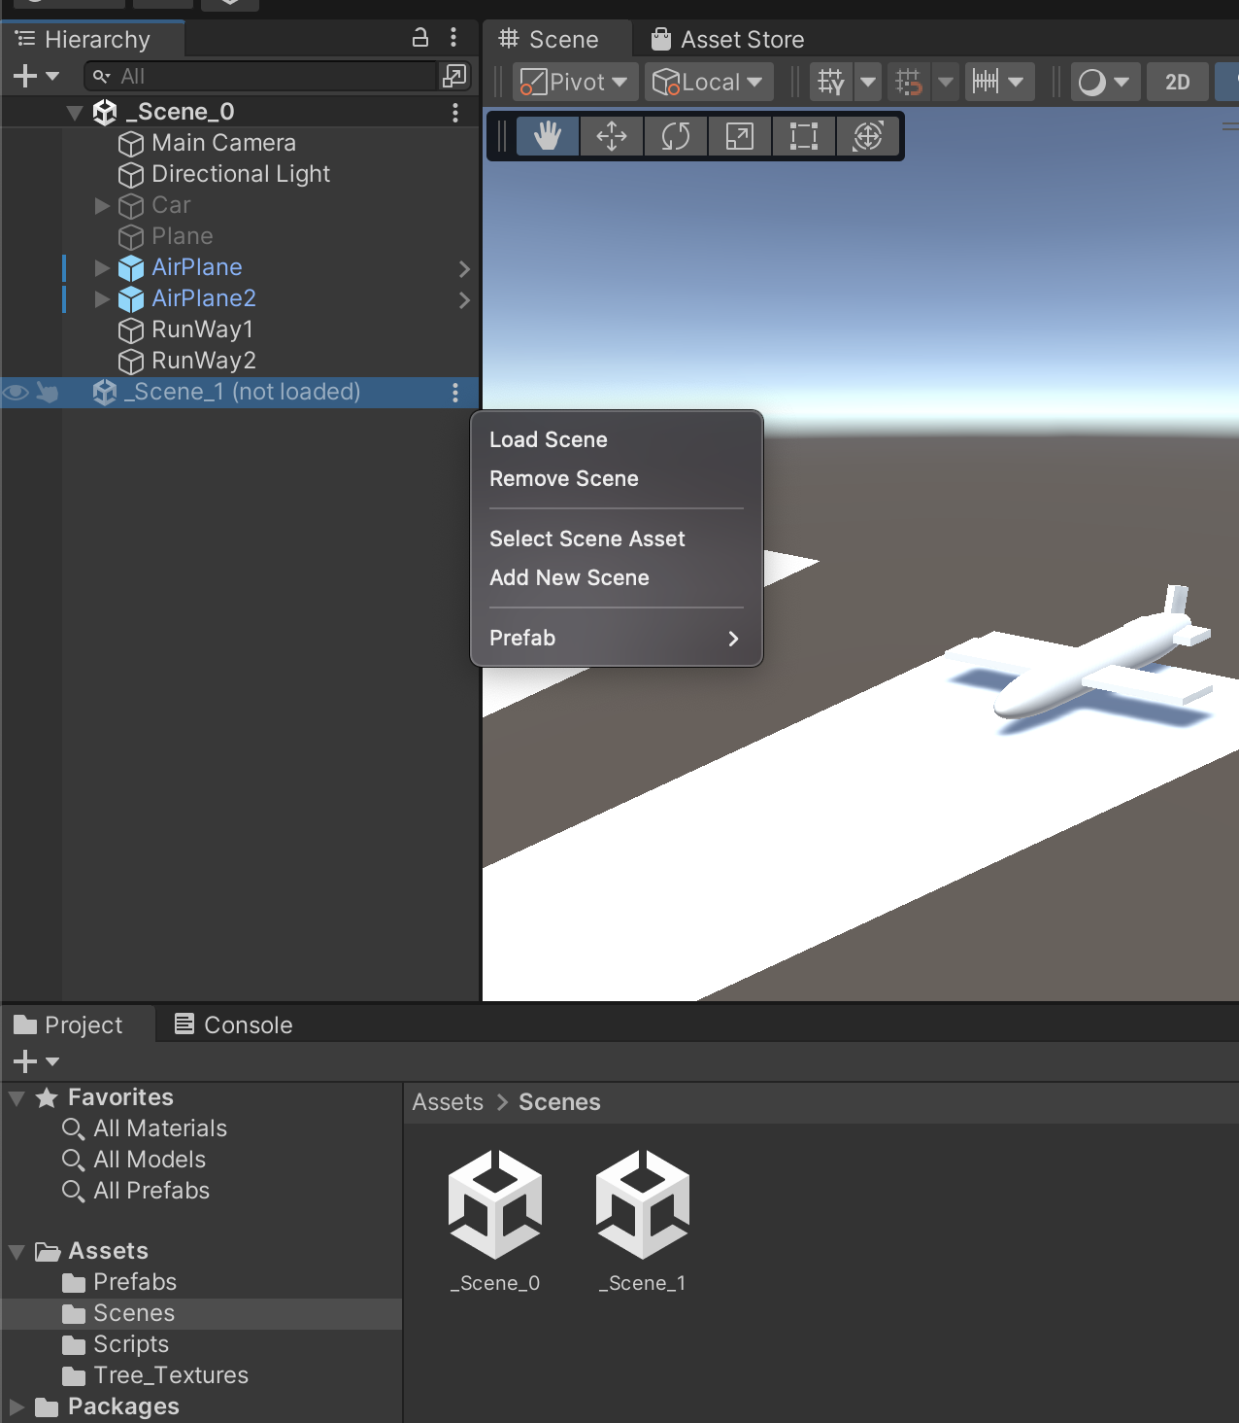
Navigating Between Scenes
UnityEngine.SceneManagement provides functionalities for managing scenes, including switching between them, adding/removing scenes, and controlling their states
Loading Scenes: Use SceneManager.LoadScene() to load a new scene, either by scene name or by index in the build settings.
Unloading Scenes: Use SceneManager.UnloadScene() to remove unnecessary scenes when they're no longer needed.
Scene Switching: Use SceneManager.LoadScene() to switch from the current scene to another.

Slide 6
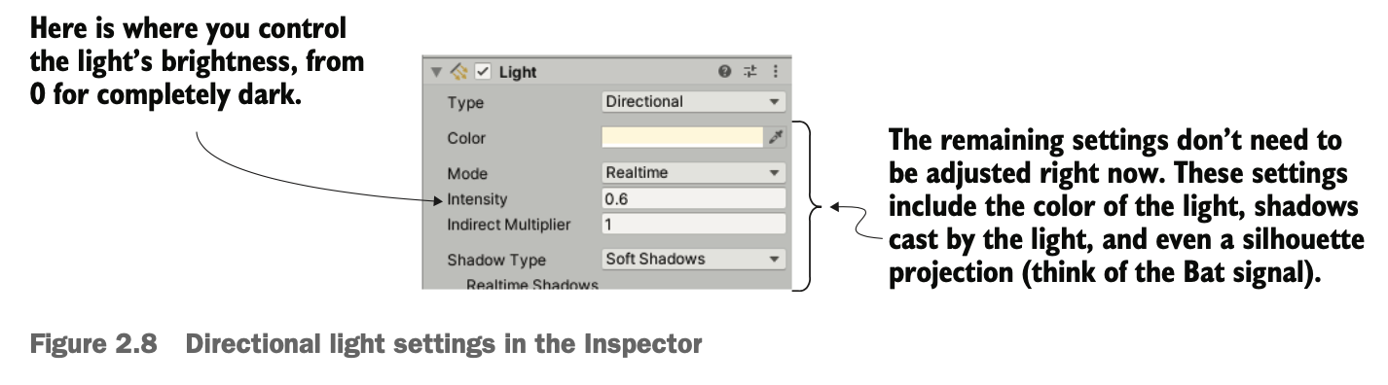
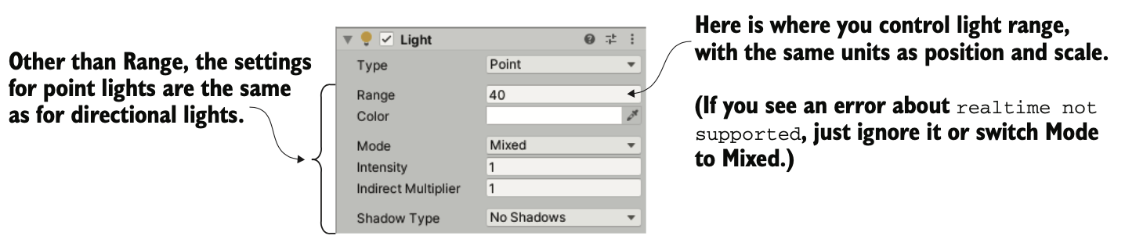
Scene Lighting and Camera Setup
Types of lights: You can create several types of light sources, defined by how and where they project light rays. The three main types are point, spot, and directional.
1: Hocking, Joseph; Schell, Jesse, Unity in action: multiplatform game development in C#, 2022

Slide 7
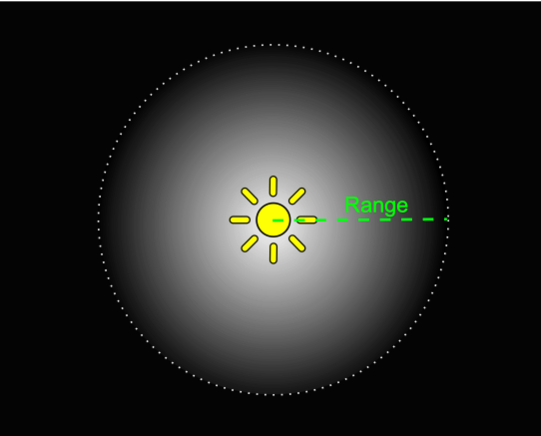
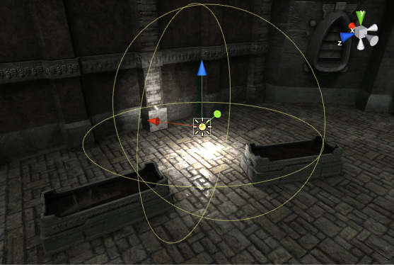
Scene Lighting and Camera Setup
In point lights, all the light rays originate from a single point and project out in all directions, like a light bulb in the real world. The light is brighter up close because the light rays are bunched up.
Point lights are useful for simulating lamps and other local sources of light in a scene. You can also use them to make a spark or explosion illuminate its surroundings in a convincing way.
8: Unity Technologies, Unity Manual, 2023

Slide 8
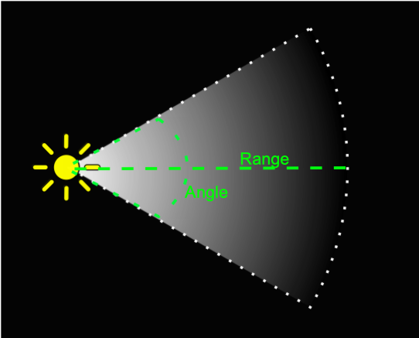
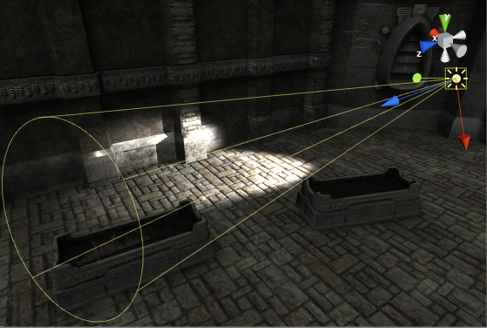
Scene Lighting and Camera Setup
In spot lights, all the light rays originate from a single point but project out in only a limited cone. No spot lights are used in the current project, but these lights are com- monly used to highlight parts of a level.
8: Unity Technologies, Unity Manual, 2023

Slide 9

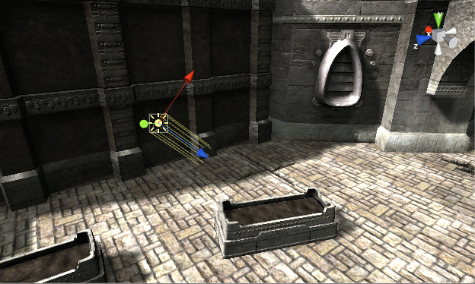
Scene Lighting and Camera Setup
In directional lights, all the light rays are parallel and project evenly, lighting everything in the scene the same way. This is like the sun in the real world
8: Unity Technologies, Unity Manual, 2023

Slide 10
Scene Saving and Loading
Scene saving and loading in Unity involves preserving the state of a scene so that it can be restored or reloaded at a later time. This process is crucial for games where players need to save their progress or return to specific points within the game.
Notes:
Data Collection:
Identify and gather relevant data that needs to be saved, such as:
Positions, rotations, and states of game objects.
Player inventory, progress, or game settings.
Any other critical information related to the scene's state.
Serialization:
Convert this gathered data into a serializable format (JSON, XML, binary, etc.) using Unity's serialization techniques or custom serialization methods.
Unity's built-in serialization system (e.g., JsonUtility, BinaryFormatter) or custom serialization scripts can be used here.
Storage Management:
Save the serialized data to a storage medium (local files, player prefs, databases, etc.) to persist across game sessions.
Choose an appropriate storage method based on the complexity of the data and the required security or accessibility.
Loading Process:
Retrieve the saved data from storage when needed, such as when a player wants to resume a saved game or reload a specific scene state.
Deserialize the data to convert it back into usable game information.
Scene Reconstruction:
Use the deserialized data to reconstruct the scene's previous state, setting object positions, restoring player progress, and applying any other saved information.
Implementation in Unity:
Unity offers PlayerPrefs for simple data storage, and developers can also create custom scripts to manage more complex data saving/loading.
ScriptableObjects, PlayerPrefs, or external files are commonly used to save game settings, player progress, or scene states.

Slide 11
Scene Saving and Loading
Data Collection: Identify and gather relevant data that needs to be saved
Serialization: Convert this gathered data into a serializable format (JSON, XML, binary, etc.) using Unity's serialization techniques or custom serialization methods.
Storage Management: Save the serialized data to a storage medium to persist across game sessions.
Loading Process: Retrieve the saved data from storage when needed, such as when a player wants to resume a saved game or reload a specific scene state

Slide 12
Scene Saving and Loading
Scene Reconstruction: Use the deserialized data to reconstruct the scene's previous state, setting object positions, restoring player progress, and applying any other saved information.
Implementation in Unity: Unity offers PlayerPrefs for simple data storage, and developers can also create custom scripts to manage more complex data saving/loading.
ScriptableObjects, PlayerPrefs, or external files are commonly used to save game settings, player progress, or scene states.

Slide 13
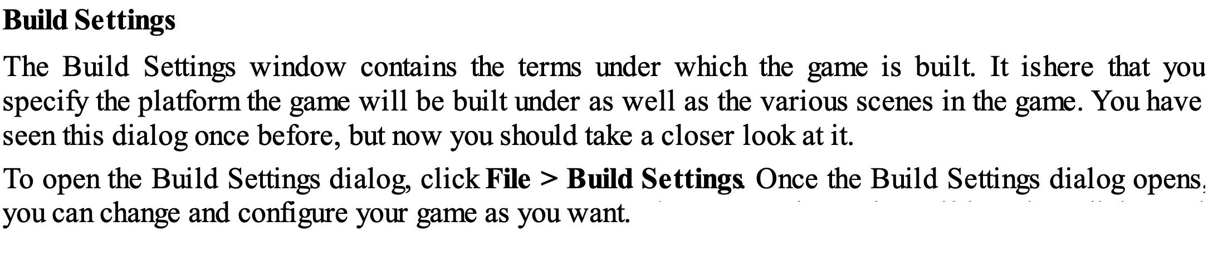
Build Settings and Player Configuration
3: Geig, Mike, Sams teach yourself Unity Game development in 24 hours, 2014

Slide 14
Build Settings
Adding scenes to Build Settings in Unity is a crucial step when preparing to build your game. This process determines which scenes you've created in the Editor will be included when you publish your game.
Add Scenes
Drag and drop scenes from the Project Window into the "Scenes In Build" section or click on "Add Open Scenes" to automatically add scenes that are currently open in the Editor.
The scene at the top of the list will be the initial scene loaded upon starting the game.
Adding scenes to Build Settings not only determines the game's startup sequence but is also a crucial step in defining the necessary content for the final build, optimizing performance, and enhancing the overall player experience.

Slide 15
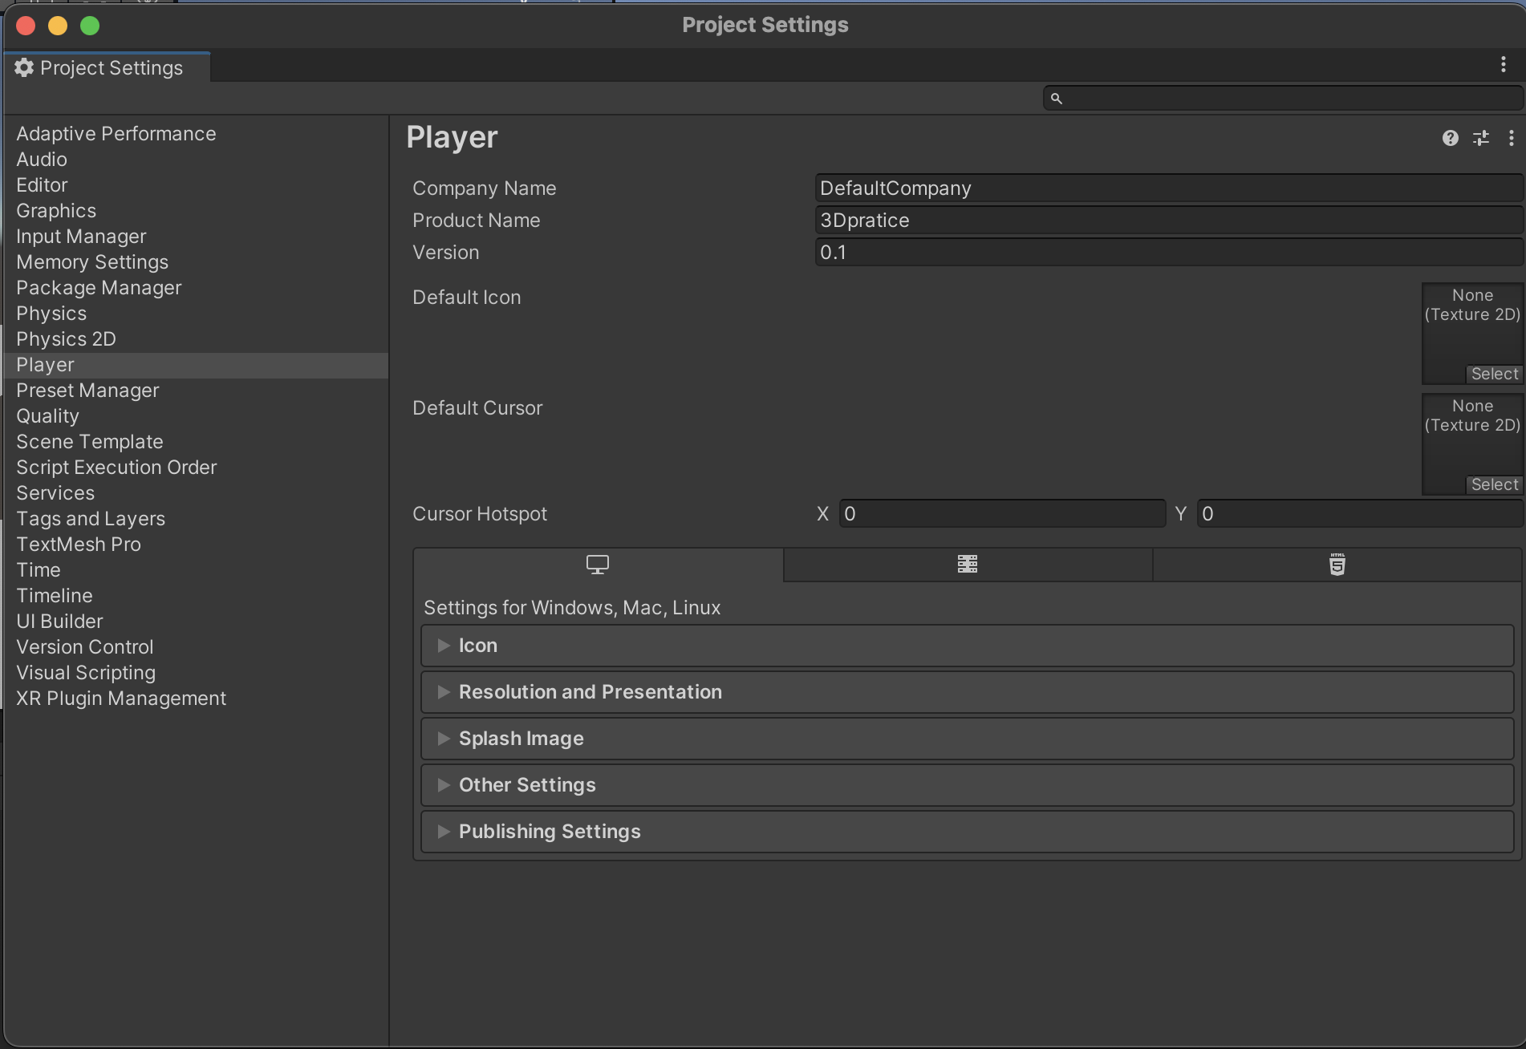
Player Configuration
In Unity, when exporting a build you are effectively placing your content into what is known as the Unity player. As a standalone build, the player is part of the packaged executable PC or Mac game.
10: Goldstone Will, Unity 3.x game development essentials, 2011

Slide 16
Player Configuration
In Player Settings, you can specify certain elements, such as resolution, icons and rendering settings, for the player to use.
The Player Settings in Unity are divided into two core separations—Cross-Platform Settings and Per Platform Settings.

Slide 17
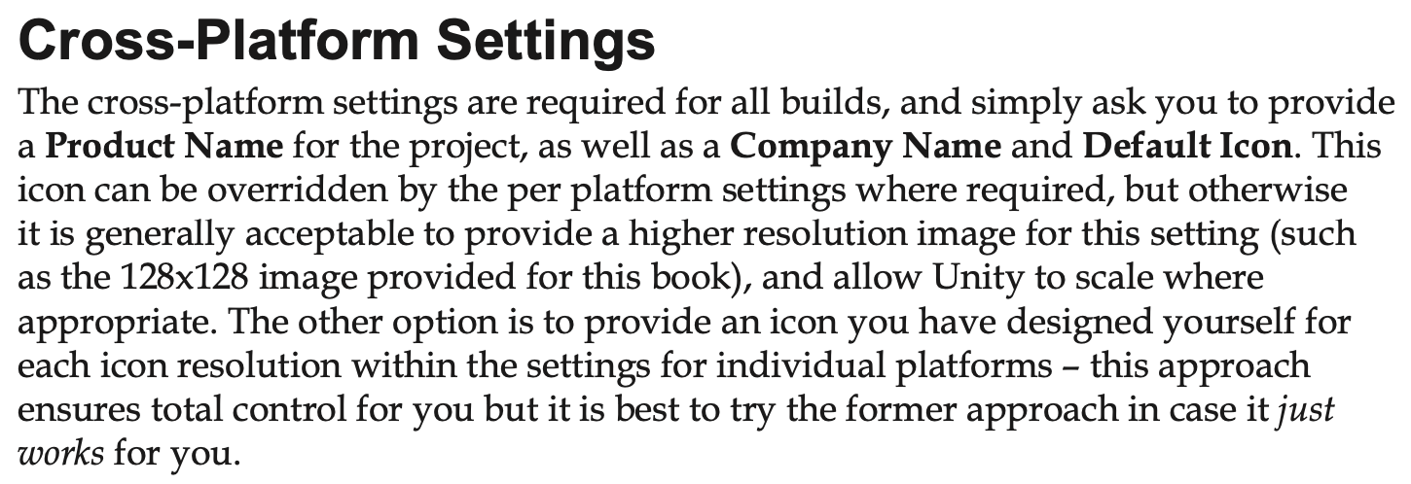
Player Configuration
10: Goldstone Will, Unity 3.x game development essentials, 2011

Slide 18
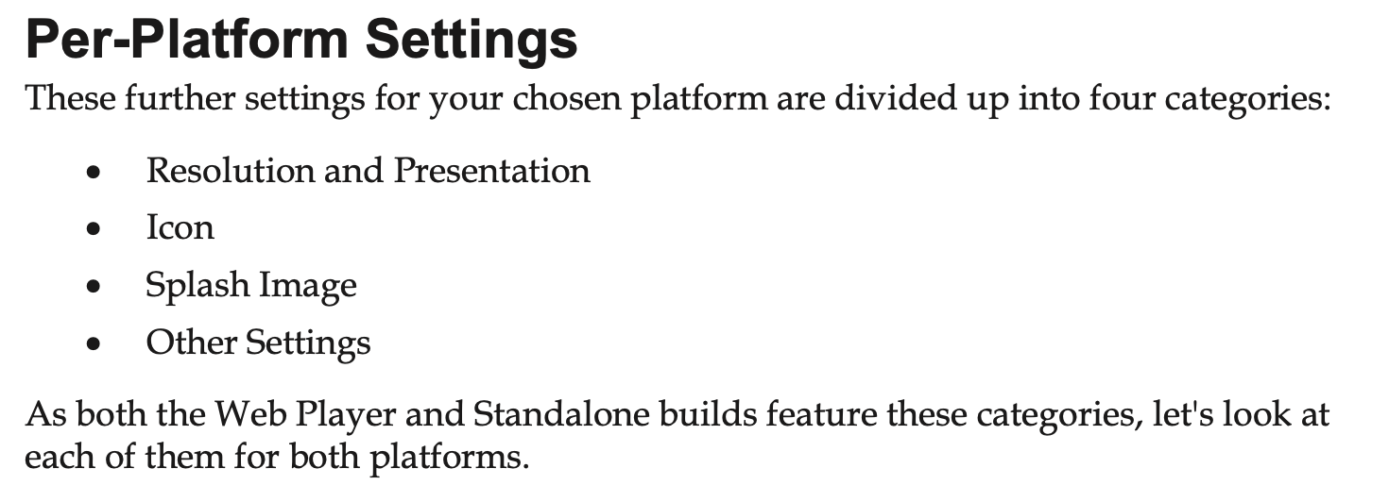
Player Configuration

Slide 19
Practical Exercise - Scene Creation
Change name of current scene to _Scene_0
Create new scene for Airplane game, called _Scene_1.
Create Prefab for Airplane GameObject in _Scene_0
Drag and drop Airplane Prefab to new scene and change its name to Player.
Advance practice
Create the level exit trigger, and switch to _Scene_1 when the airplane go through the trigger cube.
Notes:
The exercises for this lesson are aimed at getting students familiar with the operations of working with scenes and prefabs.

Slide 20
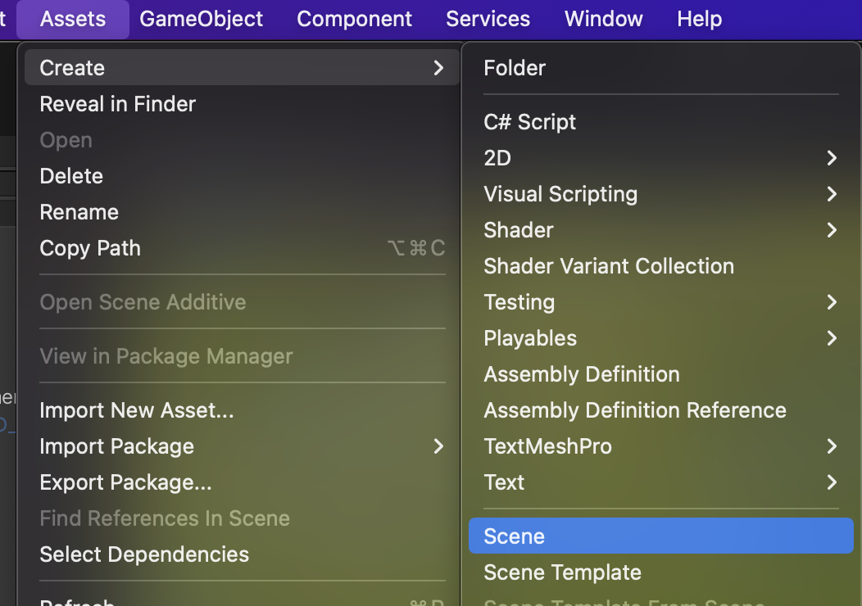
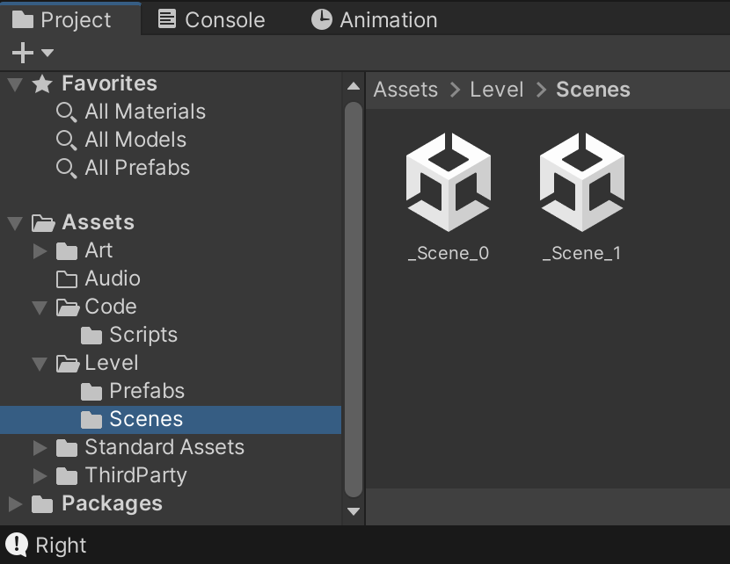
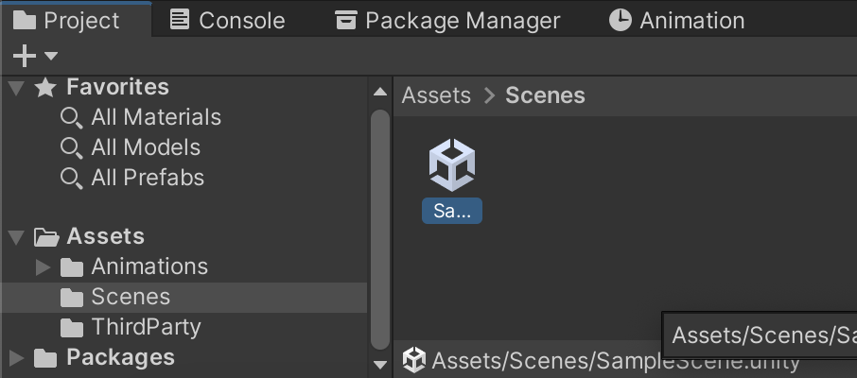
Practice 1 – Create new scene
In the Assets folder, create Level folder. Move Scenes folder to Level folder.
Rename ‘SampleScene’ scene to ‘_Scene_0’
In the Scenes folder, select Assets menu > Create > Scene . Rename new scene to ‘_Scene_1’
Notes:
Practice Resources sharing:
https://drive.google.com/drive/folders/1eXu20cX1o-5uMFuSeHGxRS5AkhDZJTOP?usp=sharing

Slide 21
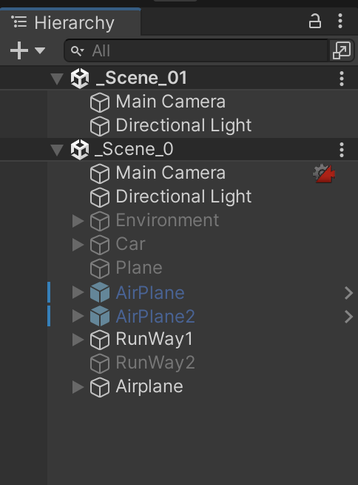
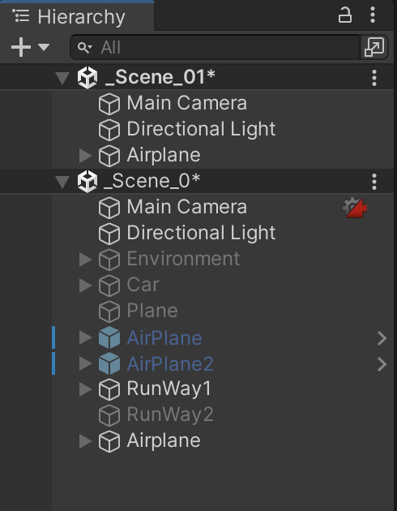
Practice 2 – Duplicate and copy Player to new Scene
Open _Scene_1 by double click on _Scene_1 icon.
Drage and drop _Scene_0 to Hierarchy panel to open multiple scene.
Select Airplane and press Control + D to duplicate.
Drag and drop new object to new scene _Scene_1.

Slide 22
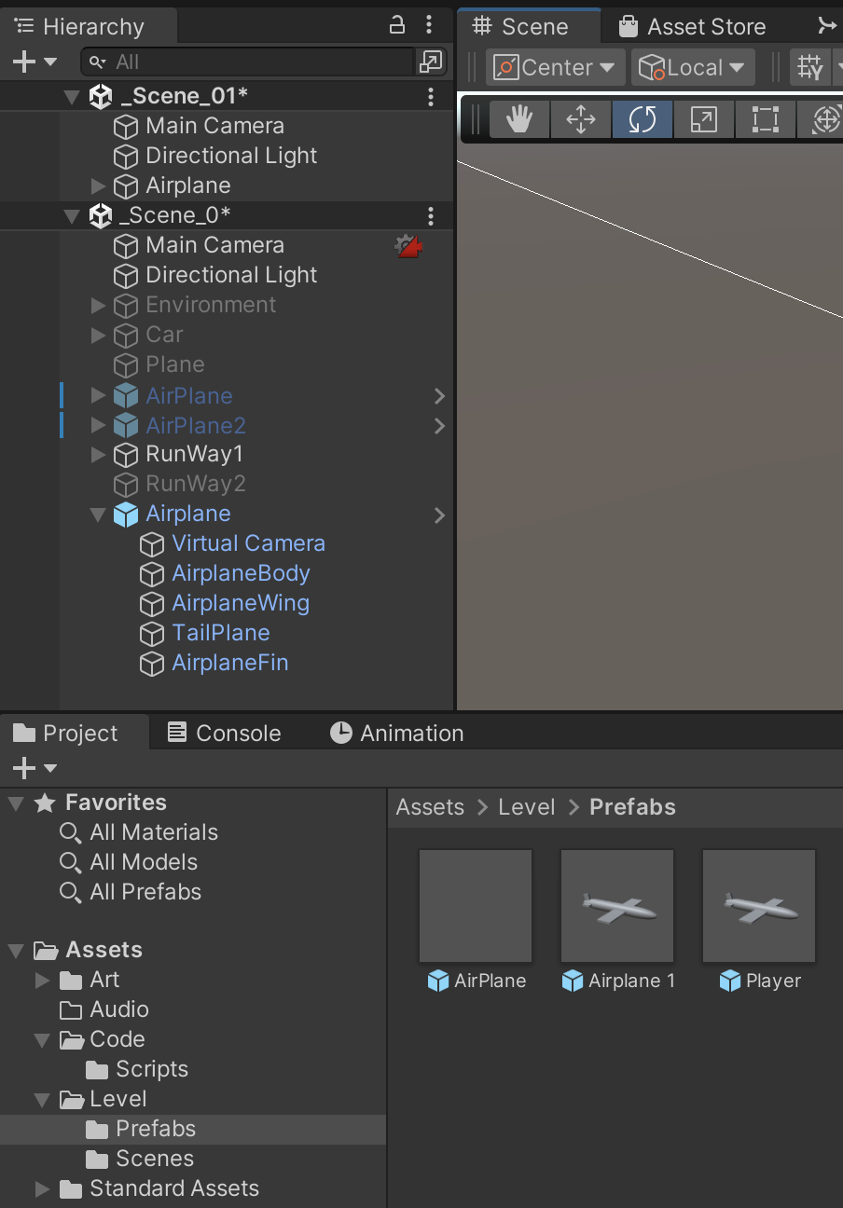
Practice 2 – Prefab creating and using
To create a prefab from a GameObjec. Choose GameObject, drag and drop GameObject to Assets folder of Project Panel.

Slide 23
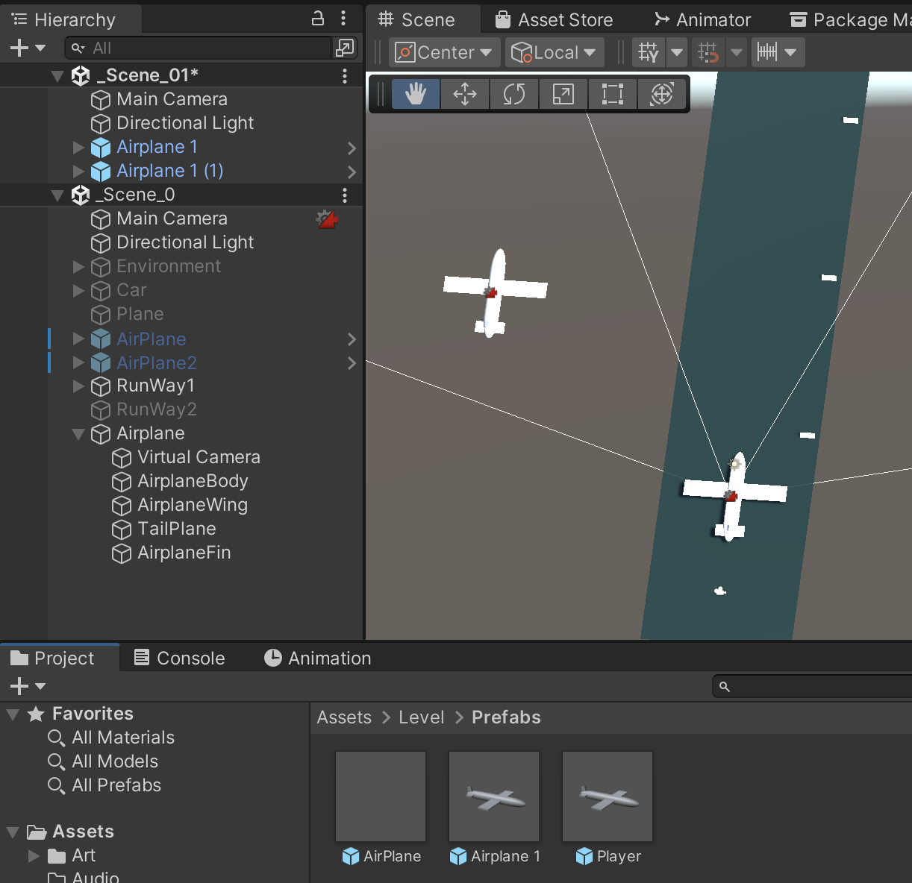
Practice 2 – Prefab creating and using
To add GameObject to scene from a prefab, drag and drop prefab to Scene panel or Hierarchy panel.

Slide 24
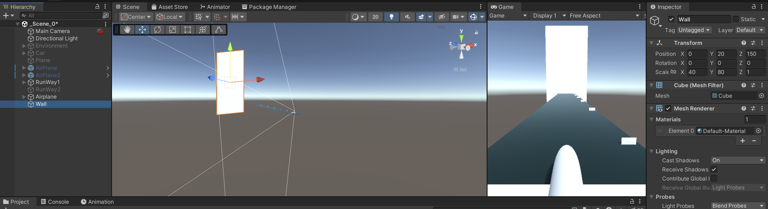
Practice 3 – Scene switching
1. Add a cube, edit transform to make a wall.
Transform values:
Position: 0, 20, 150
Scale: 40, 80, 1

Slide 25
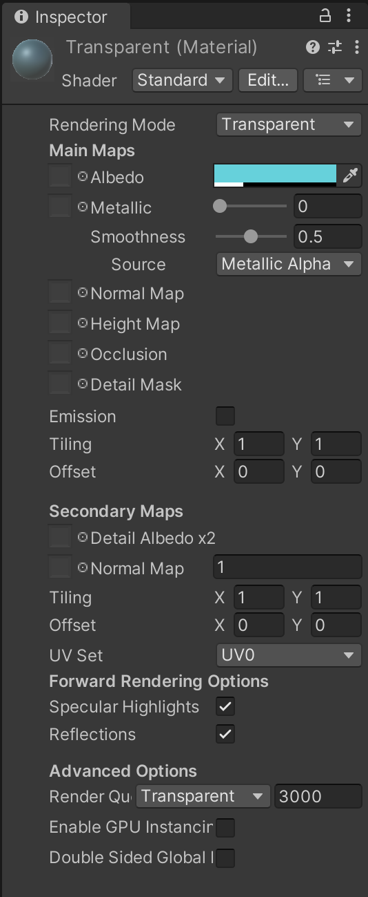
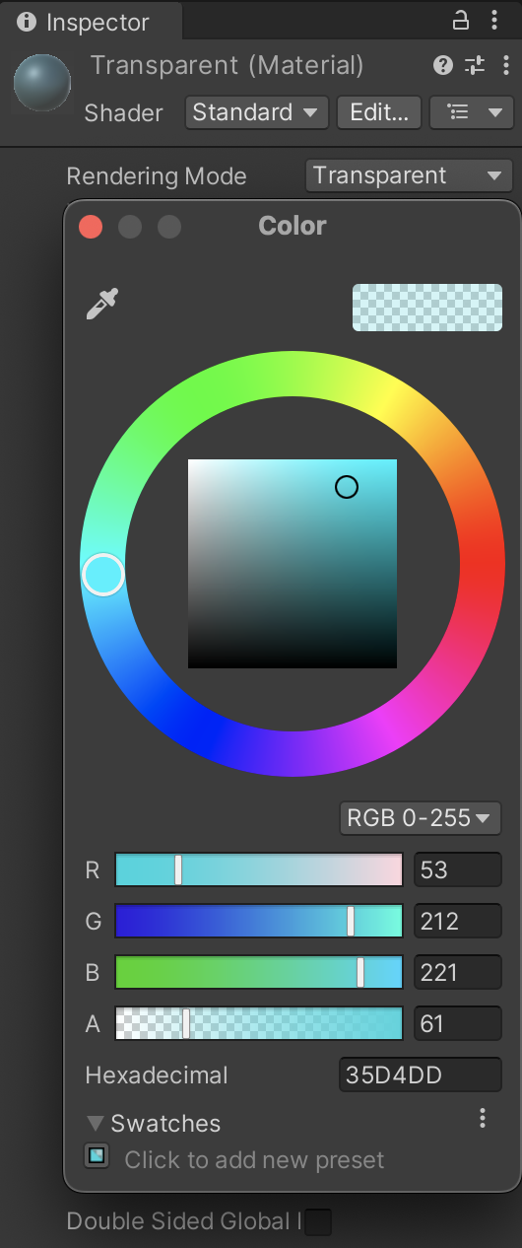
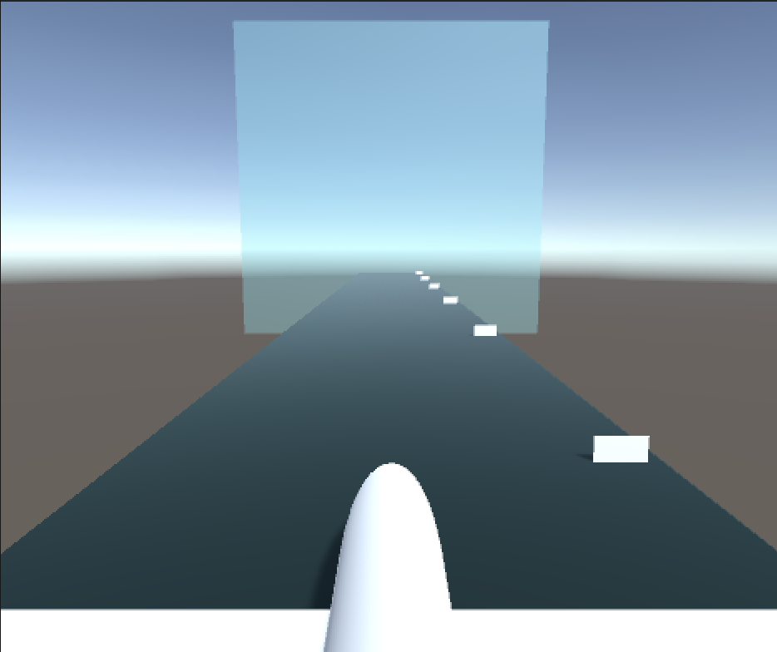
Practice 3 – Scene switching
2. Make transparent wall by add and apply transparent material to Wall object

Slide 26
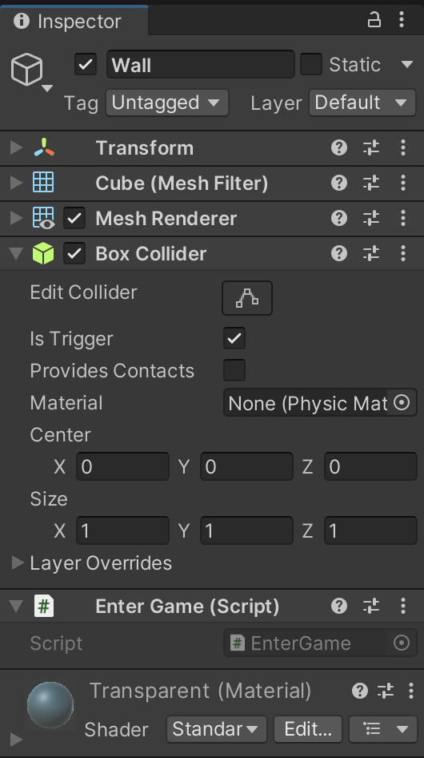
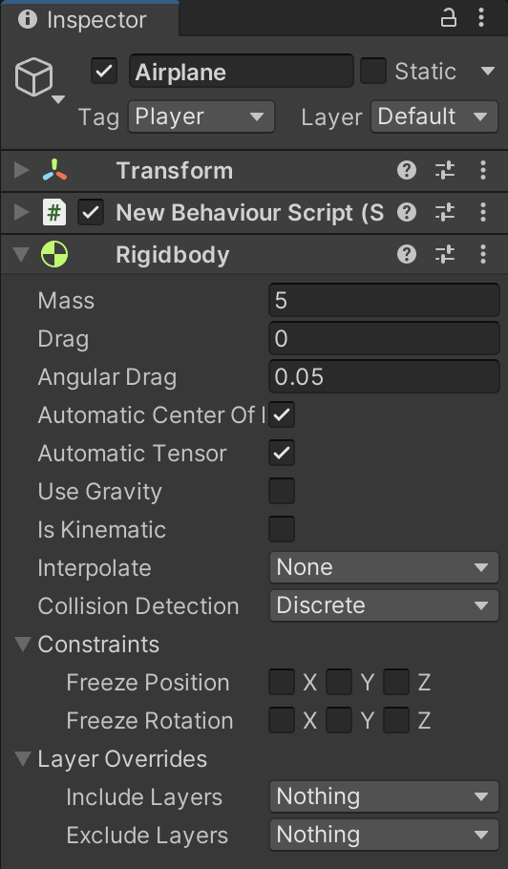
Practice 3 – Scene switching
Add trigger to GameObject. Steps to add trigger:
- Wall Object:
in Box Collider component: check ‘is Trigger’
add script component: ‘EnterGame.cs’
- PlayerObject:
add tag ‘Player’ to game object.
add Rigidbody component and uncheck ‘Use Gravity’.
- Script Component: add function OnTriggerEnter

Slide 27
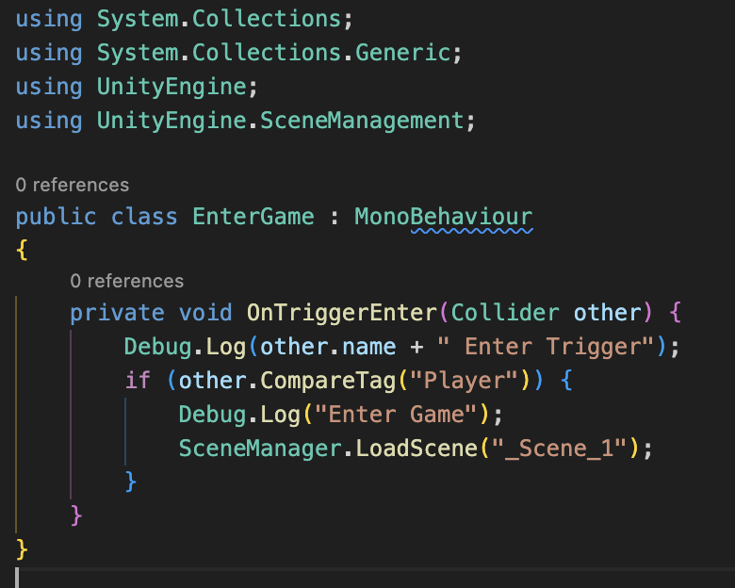
Practice 3 – Scene switching
EnterGame.cs
public class EnterGame : MonoBehaviour
{
private void OnTriggerEnter(Collider other) {
Debug.Log(other.name + " Enter Trigger");
if (other.CompareTag("Player")) {
Debug.Log("Enter Game");
SceneManager.LoadScene("_Scene_1");
}
}
}

Slide 28
Conclusion and Next Steps
Scene Fundamentals: Explored scenes as distinct segments crucial for structuring games, emphasizing their impact on overall project flow.
Practical Techniques: Covered scene creation, navigation, organization strategies, lighting, camera setup, saving/loading scenes, Build Settings, and Player Configuration.
Hands-on Experience: Participants engaged in practical exercises, creating scenes, adding and organizing game objects, enhancing their proficiency in scene management.

Slide 29
References
1: Hocking, Joseph; Schell, Jesse, Unity in action: multiplatform game development in C#, 2022
3: Geig, Mike, Sams teach yourself Unity Game development in 24 hours, 2014
6: Gibson Bond, Jeremy, Introduction to Game Design, Prototyping, and Development: From Concept to Playable Game with Unity and C,
8: Unity Technologies, Unity Manual, 2023
10: Goldstone Will, Unity 3.x game development essentials, 2011

